Slide 1

by Nikki Aaron, Tristan Benedict-Hall, Aaron Brinkley, & Kevin Surmacewicz

Slide 2
application concept
Easy and accessible way to find hiking trails, length, and difficulty
Wishlist items included: directions, wildlife and their peak times, current weather, topographic map, and allowing users to save favorites and provide those to others.

Slide 3
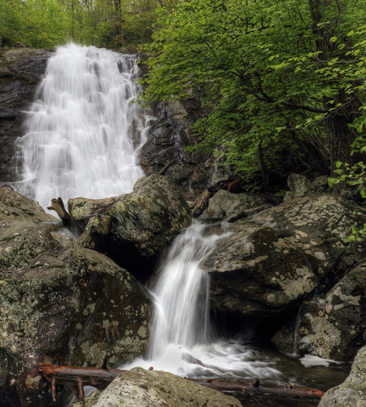
motivation
We enjoy hiking!
Promoting healthy and active lifestyles
Want users to see how easy an activity it is to enjoy.
We even discovered some local trails that we didn’t know about.
White Oak Canyon - SNP

Slide 4
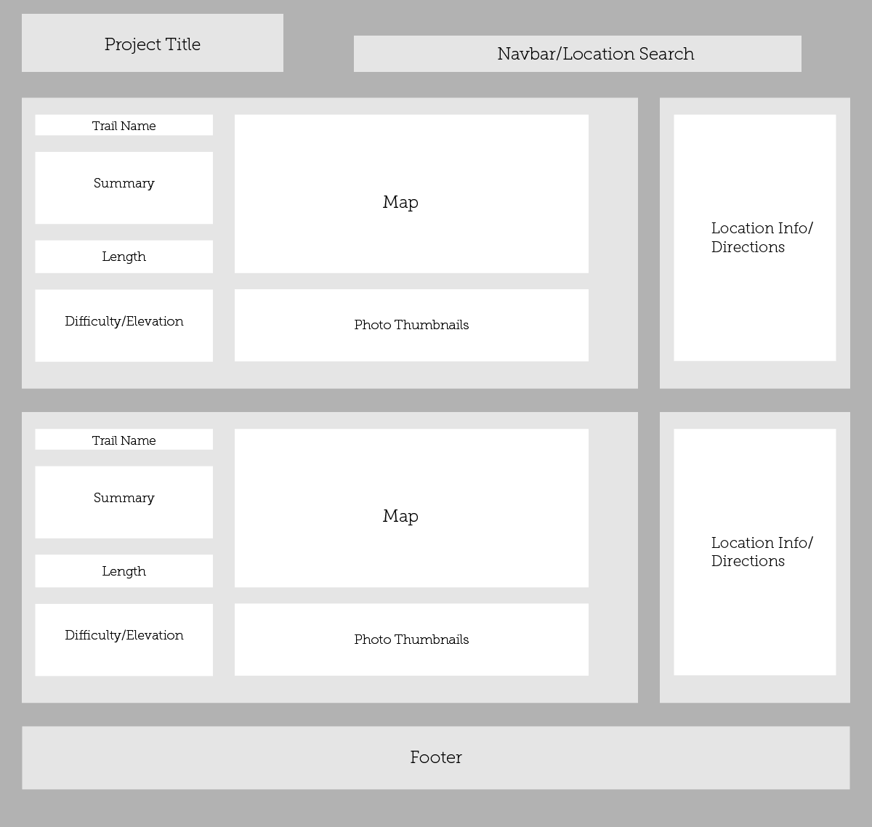
design process
Simple, clean, and easy to navigate
Started with APIs and built out from there
Make images prominent and display on initial load too
original wireframe

Slide 5
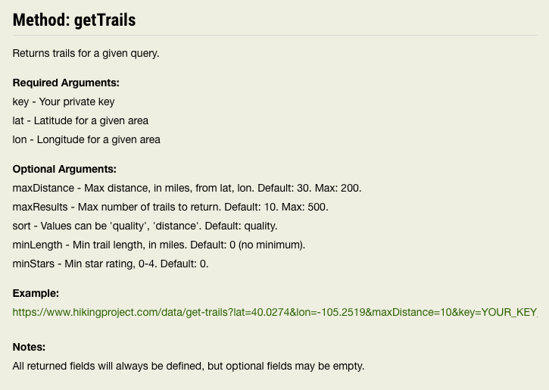
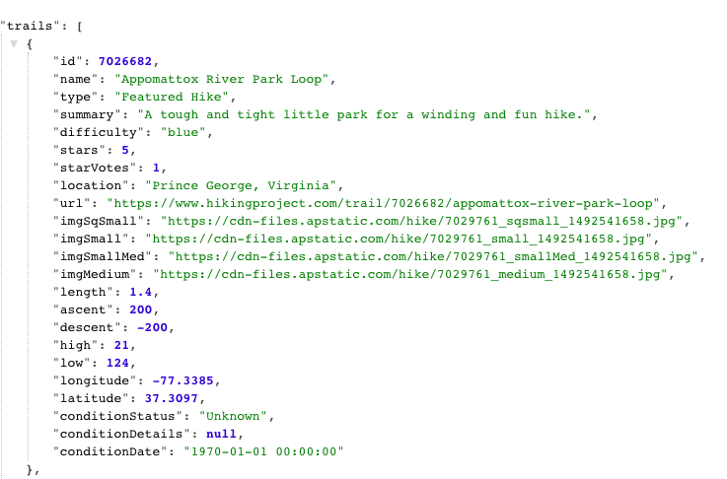
Tech used
Hiking Project API
Returned Data

Slide 6
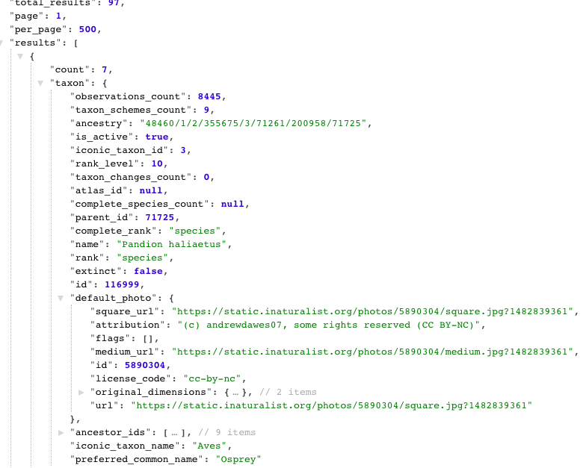
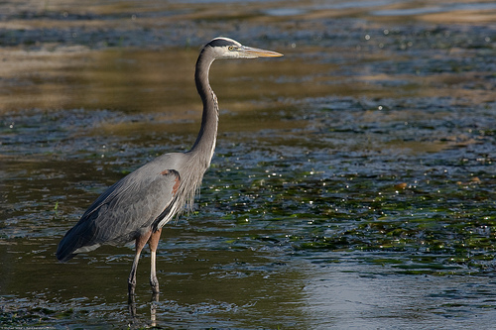
Tech used
iNaturalist API - Returned Data

Slide 7

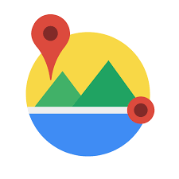


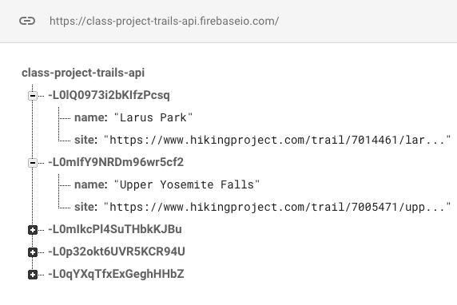


tech used
Google Maps, Places, GeoCode
MapBox
OpenWeather
Chartist
Firebase

Slide 8
demo

Slide 9
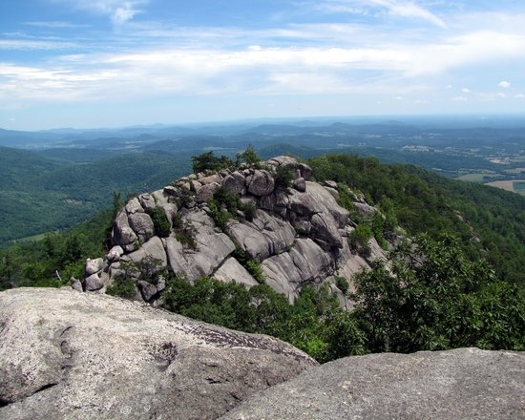
the future
User Accounts
Flickr Image Feed
Upload new GPS data for trails
Display nearby businesses to trailheads
Old Rag Mtn. - SNP

